Slide 1
Polymer Dielectric Layer Curing
Fast, Low Temperature, Low Warpage

Slide 2
Polymer Dielectrics on Wafers
Photosensitive polyimides (PI)
  Fast cure at 350°C
  Curing below 250°C
Low CTE polyimides
  Curing at 200°C
  No-warpage processing
Polybenzoxazoles (PBO)
  Curing below 200°C
  Crosslinking mechanisms
Epoxies and PHS
  Curing down to 160°C
  Half the warpage at 300 mm

Slide 3
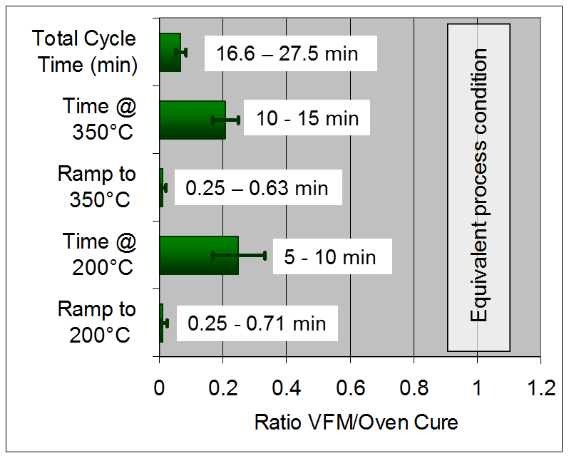
Very Fast VFM Cure of Polyimides
Two polyimides extensively used for stress buffer and RDL
  PI-5878G non-photosensitive polyimide
    Coat & soft-bake
  HD4004 photosensitive polyimide
    Coat, soft-bake & blanket expose
  Oven cure 60 min hold for 5 hr cycle time
  VFM Cure at @ 350°C with cycle times less than 30 minutes

Slide 4
PI Cure Properties Meets/Exceeds Oven Cure
Range of results for VFM cure overlaps oven cure for most properties
Differences are consistent with higher cure by VFM
Note: “Error” bars for Oven cure results show standard deviation in data. “Error” bars for VFM cure show range of responses from DOE

Slide 5
Fast VFM cure of HD4110 at 340°C
VFM process capable of same cure as oven with 94% reduction in cycle time
Results averaged for 8 VFM cured films, 9 oven cured films
Oven: 60 min@350°C, 5.0 hr cycle
VFM: 8 min@340°C, 0.3 hr cycle

Slide 6
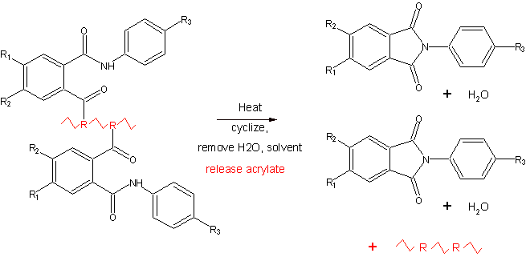
Chemistry of PSPI Curing
Photosensitive precursor releases residue with ring closure
  Acrylate residue is thermally decomposed to CO₂ and other gasses
  Removal of residue increases Tg and film shrinkage in out-of-plane axis
TWO parts of “cure”:
  imidization : necessary for chemical stability
  acrylate removal : necessary for high Tg and thermal stability
CO2, other gasses

Slide 7
Fast VFM cure does not leave residuals
Residual polyacrylates in oven cure (by DMA, TGA, and DSC)
TGA
DMA shows Tg from polyacrylate and polyimide
Weight loss from polyacrylate burn-out
Tg of polyacrylate
Polyimide Tg is not seen in DSC

Slide 8
Low Temperature Polyimide Curing

Slide 9
Previous Polyimide Results
A measure of microwave cure efficiency is the comparison of the final film Tg as cured conventionally and by VFM.
Example: convection cure at 4 hrs at 350ºC for Tg = 310ºC
VFM cure at 1.5 hrs at 150ºC for Tg = 310ºC
Tg Ratio = 1.0

Slide 10
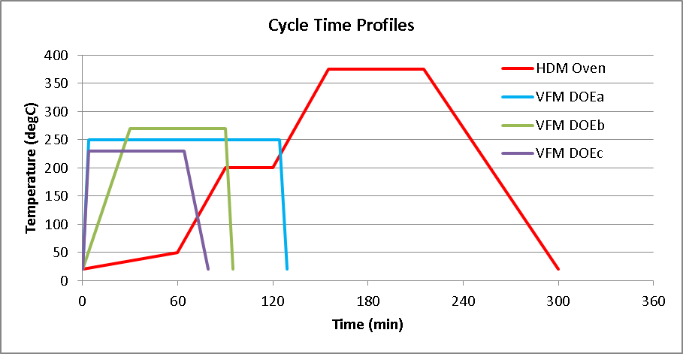
VFM Cure of Polyimide at Low Temperatures
Low temperature cure AND faster total cycle times possible?
Compare film properties of oven and VFM cure profiles
“Cure time” is often given as soak time, not cycle time
Slow oven ramp to soak is used to reduce film stress and warpage
Oven 375C
VFM 270C
VFM 250C
VFM 230C
soak
soak
Standard oven cycle vs. example VFM cycles for HD4100

Slide 11
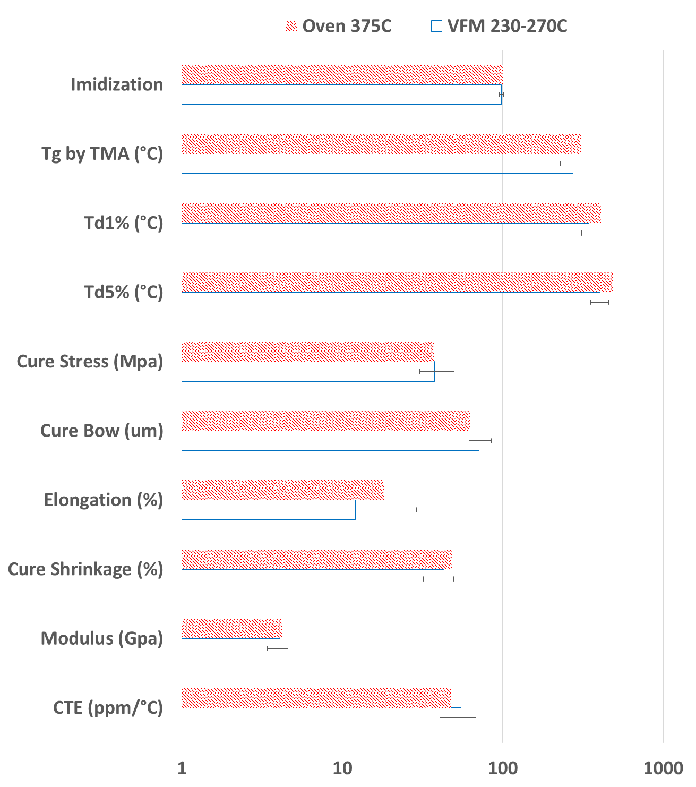
Properties: 375°C oven vs. 230-270°C VFM
DOE results:
These are NOT
error bars. They
represent the range
of real results from
changes of variables.

Slide 12
Property Trade-offs
Examples of actual data (equivalent cure by IR):
Lowest cure (230°C) has similar bow; lower Tg
Medium cure (270°C) has similar Tg; higher bow
Long ramp to soak not necessary with VFM
 | Temp C | Time Hrs | Oxygen ppm | Tg C | Td1% C | Td5% C | Stress MPa | Bow mm
Standard | 375C | 5 | <100 | 310 | 410 | 487 | 37.3 | 63
Standard * | 350C | 5 | <100 | 256 | 382 | 432 | 28.3
VFM * | 350C | 0.2 | <20 | 330 | 463 | 497 | 31.6
VFM | 230 | 3 | air | 282 | 336 | 394 | 31.8 | 67
VFM | 250 | 2 | air | 306 | 365 | 429
VFM | 270 | 1 | air | 337 | 374 | 454 | 44.5 | 77
VFM | 270 | 1 | <20 | 236 | 336 | 392 | 30.6 | 62
* Zussman et.al., Symposium on Polymers, 2008

Slide 13
CTE-Matched Polymer Dielectric
Needs for a dielectric layer for 2.5D
  CTE = 3-4 ppm/°C
  Good dielectric properties and stability
  Low stress and warpage
  Compatibility with under 250°C processing
  High Volume Manufacturing Solution
Dielectric Material | CTE (ppm/°C)
SiO₂ | 0.5
Silicon | 3
Glass | 4
BT, FR4 | 18
Polyimide | 35
BCB | 42
Epoxy | 60
PBO | 60
Standard oven cure
250-375 C
Notes:
Can’t we just MATCH the CTEs?
Other polymer dielectrics – same problem

Slide 14
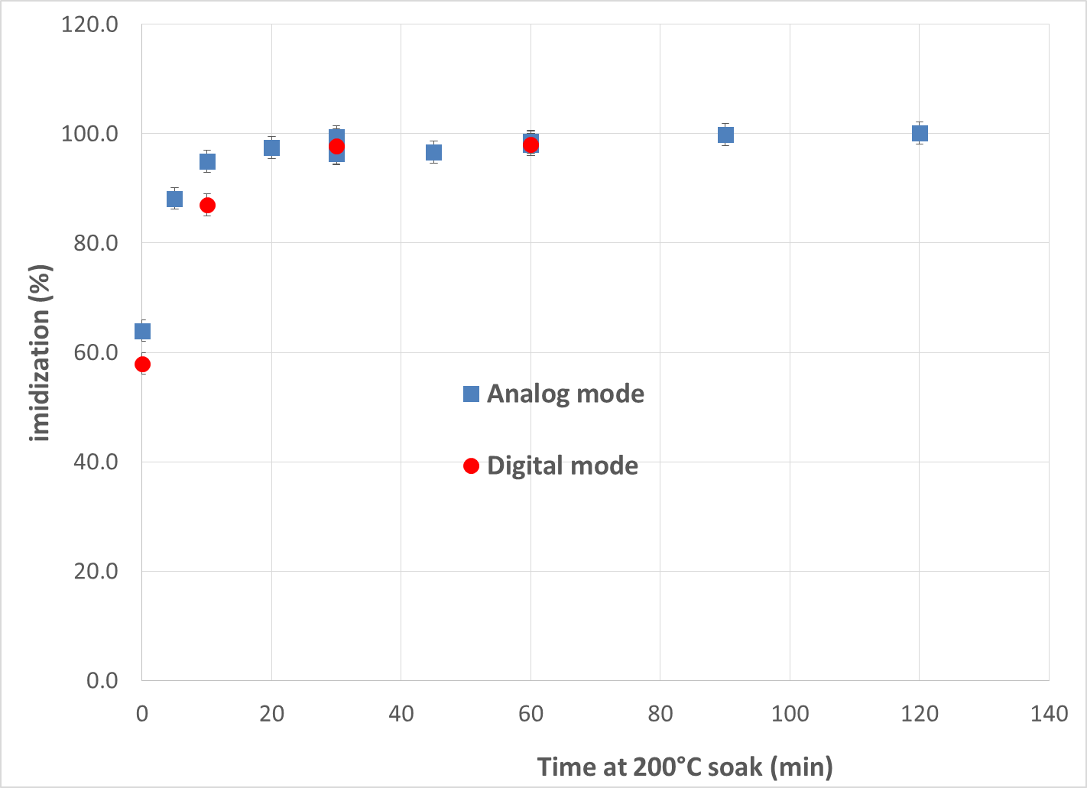
Extent of PI-2611 Cure with VFM at 200°C
98-100% imidization after 30 minutes
Ramp rates are fast (> 30°C/min) but don’t affect cure/stress/warpage
Notes:
3-5 samples – 3 meas each

Slide 15
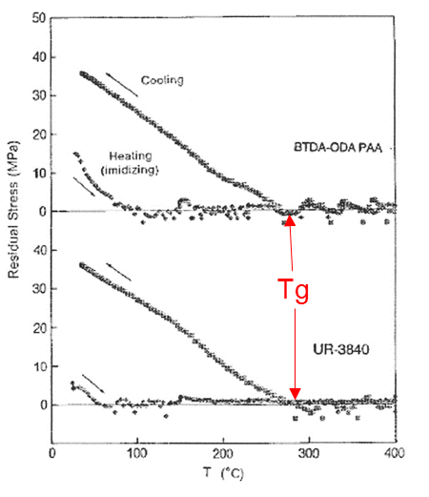
Same Semi-crystalline Thermoplastic?
  Oven cure ≥ 350°C begins densification/crystallization
  VFM cure at 200°C (well below Tg∞ and Tg)
    CTE of 3 ppm/°C and modulus of 7 GPa
    highly anisotropic, layered, linear structure remains
    No indication of crystallization and 5X increased stress
    CTE-matched cured film to silicon and glass

Slide 16
Warpage of Cured Films on Thinned Silicon
Warpage vs. temperature (Projection Moiré Interferometry )
Bow of 200mm diameter wafers ground to 100um thickness:
Silicon dice
27mm x 19mm x 100μm
5μm thick PI
less than 15μm warpage
After grinding | After 350°C oven | After 200°C VFM
-100 um | -86um | -95um
Notes:
The wavy pattern is just an artifact of measurement.
Not 2X warpage but NO additional warpage

Slide 17
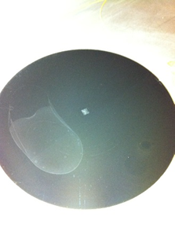
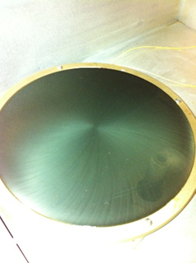
Temporary Bonding Remains
200mm wafers temporarily bonded to glass carriers
VFM cured films on backside
250°C cure 200°C cure
unwanted adhesion temporary adhesion

Slide 18
Low Temperature Curing of PBOs with VFM

Slide 19
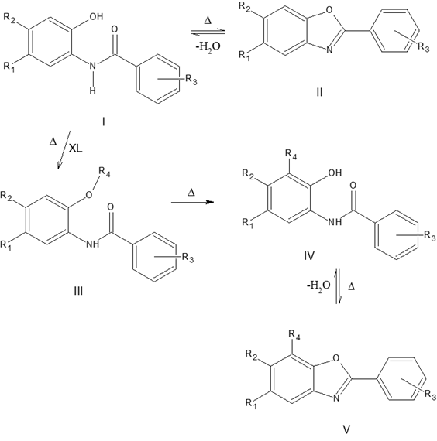
PBO Curing is More Complex
Advantages of polybenzoxazole (PBO) dielectric films
  Similar thermal and chemical stability to polyimides (PI)
  Aqueous development rather than solvent-based
  Higher elongation to break than polyimides
  Lower temperature cure potential ( less than 300°)
Cyclization and crosslinking reactions

Slide 20
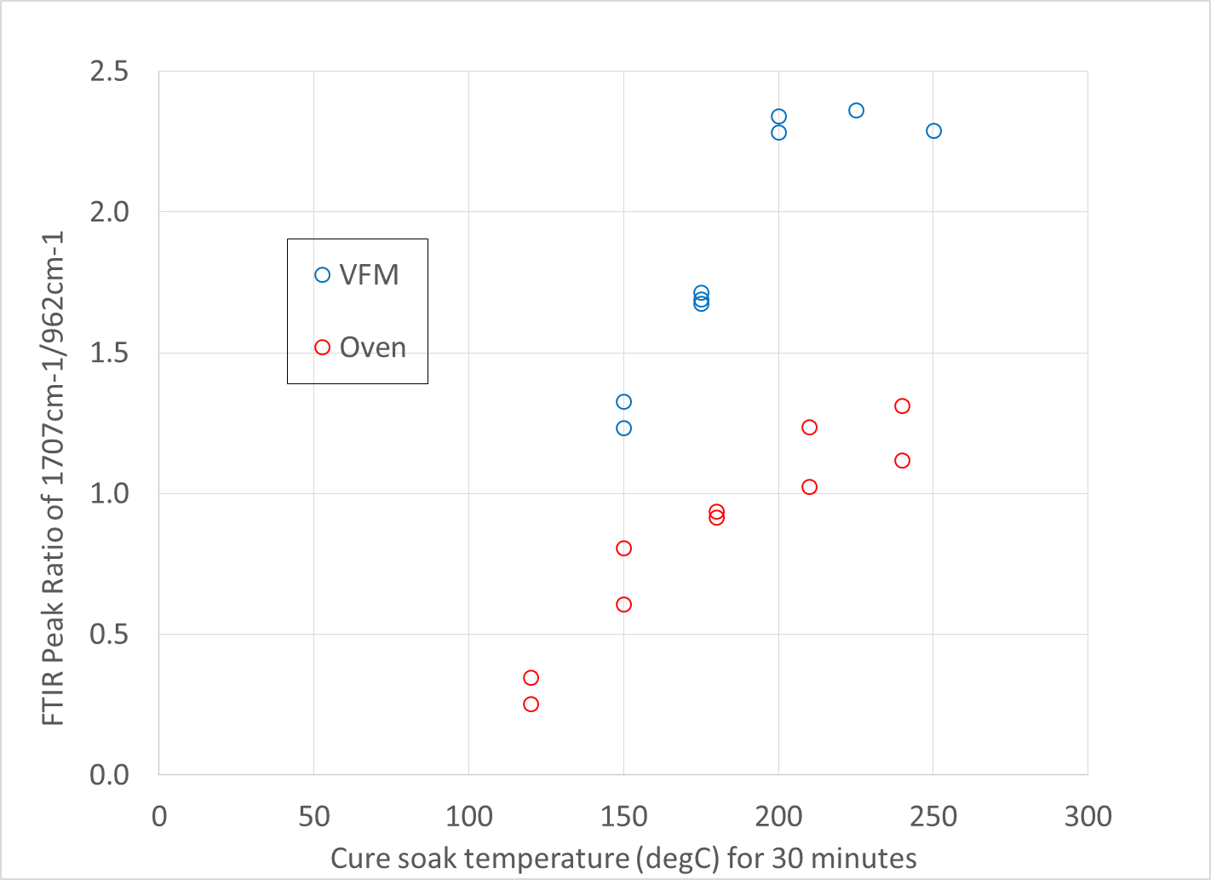
First Set Chain-extension Data
Twice the extent of chain-extension by 200°C with VFM.
Chain-extension slowing by 250°C with oven.

Slide 21
Molecular Design
If the primary goals are highest cyclization and highest Tg:
  Use an alicyclic backbone and a crosslinking agent with a low dipole moment
    If an aromatic backbone is preferred, then use a high dipole agent
  Use a cyclization promoter and a low dipole endcap
    If a high dipole encap is used, the promoter doesn’t matter
  Use NMP solvent rather than GBL
To decrease the residual solvents and water in the film
  For an alicyclic backbone use low amount crosslinking agent
  For an aromatic backbone use high amount crosslinking agent
  Use a high dipole endcap with promoter
    OR a low dipole endcap with/without promoter
Note that Time and Temperature are relatively unimportant!

Slide 22
Confirmation Runs
Results suggest confirmation runs:
Predicted results from the models:
Eighteen patterned wafers to determine effect on via slope (5 & 7 μm)
 | Backbone | Crosslink dipole | Crosslink amt. | Endcap dipole | Promoter
1 | Alicyclic | 6.53 | low | 2.66 | addn
2 | Aromatic | 7.56 | low | 2.66 | addn
3 | Aromatic | 7.56 | high | 2.66 | addn
Mtl-Temp | Cycl. % | Tg | Td5%
1-170°C | 101.4 | 286.3 | 312.0
1-185°C | 108.9 | 248.6 | 353.6
1-200°C | 116.3 | 210.8 | 395.2
2-170°C | 93.7 | 264.1 | 380.9
2-185°C | 101.2 | 226.3 | 422.5
2-200°C | 108.7 | 188.6 | 464.0
3-170°C | 93.4 | 255.5 | 334.7
3-185°C | 100.9 | 248.1 | 376.3
3-200°C | 108.3 | 240.7 | 417.9

Slide 23
Summary
PBO polymers can be custom synthesized for:
  Low temperature curing with VFM
  Unique mechanical properties
    As a result of the low temperature – fast cure
    As a result of the uniform bulk cure of VFM
Next steps
  Analysis of confirmation/photolithography runs
  Further refinement and selection of structures
  Feedback from users of PBO films for passivation and WLP
  Investigation of epoxy materials in progress

Slide 24
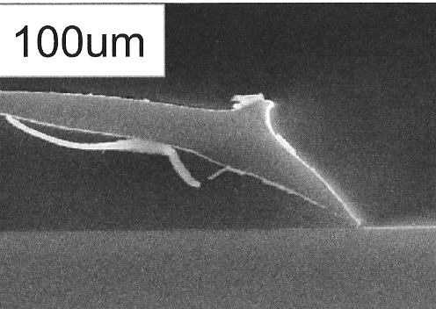
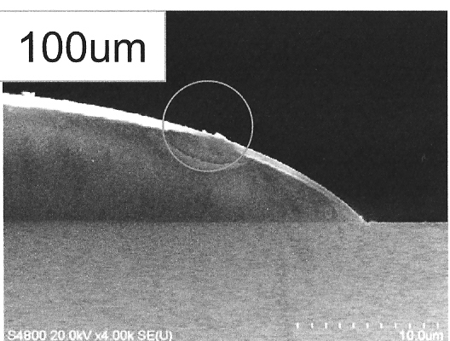
2007 Update on Patterned Wafers
Custom designed HD892X for VFM
  Confirmation runs led to more optimized formulation
  185°C full cure (Tg = 270°C)
  Elongation 70-80%, full adhesion, chemically resistant
  Smooth via profile from VFM processing
  Released for sampling to industry
oven cured VFM cured

Slide 25
Low Warpage Epoxy Wafer Cure

Slide 26
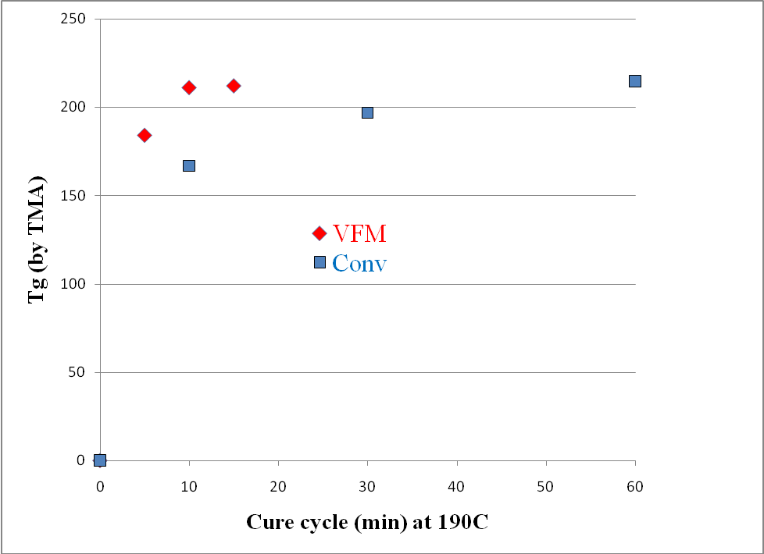
Completeness of Cure
Measurement of Tg of conventional and VFM cure samples
Ramp conditions: convection - 30 min up, 30 min down
        VFM - 3 min up, 3 min down
WPR-1201
(not including ramp times)

Slide 27
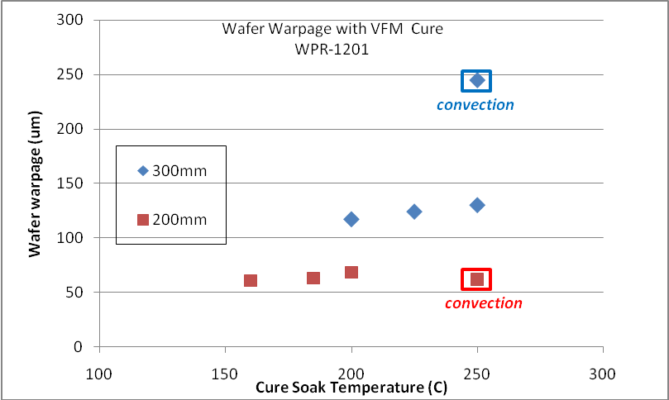
Wafer Size and Warpage
Significant reduction with 300 mm wafers even at less than 15 min
At higher temperatures (250°C) warpage remains low

Slide 28
Low Temperature Cure with VFM (neg)
Extent of cure measured by solvent (NMP) resistance
No cracking found after solvent exposure and drying
200°C complete cure of WPR-1201 (10 min)
185°C complete cure of WPR-1201 (25 min)
160°C complete cure of WPR-1201 (60 min)
Temp(°C) / time(min) | Before (μm) | After (μm) | % change
200 / 10 | 20.7 | 20.71 | 0.05
 | 20.35 | 20.35 | 0
185 / 25 | 20.23 | 20.22 | -0.05
 | 20.53 | 20.51 | -0.1
160 / 60 | 20.88 | 20.87 | -0.05
 | 20.48 | 20.48 | 0
250 / 60 C | 20.17 | 20.17 | 0

Slide 29
Low Temperature Cure with VFM (pos)
Extent of cure measured by solvent (NMP) resistance
No cracking found after solvent exposure and drying
200°C complete cure of WPR-5200 (25 minutes)
185°C complete cure of WPR-5200 (45 minutes)
160°C complete cure of WPR-5200 (90 minutes)
Temp (°C) / time (min) | Before (μm) | After (μm) | % change
200 / 25 | 20.51 | 20.5 | -0.05
 | 20.52 | 20.53 | 0.05
180 / 45 | 20.09 | 20.1 | 0.05
 | 20.24 | 20.26 | 0.1
160 / 90 | 20.54 | 20.72 | 0.88
 | 20.62 | 20.76 | 0.68
200 / 120 C | 20.55 | 20.56 | 0.05

